Slide 1

Final Year Project
Risks & Professional Issues
Dr. Clare Martin

Slide 2
Professional Issues
Professional Issues Writing tips:
• Use subsections, for each of the 4 types of issue.
• Find parts of the code of conduct that are relevant
to your project, and cite them.
Risks | Risk analysis as informed by current progress; Resolved risks and the success of the mitigation strategy; Changes to project plan as a result of risks; Future risks.
Professional Issues | Identification and discussion of relevant legal, social, ethical and environmental issues in the context of the project. Refer to professional codes of conduct, e.g. BCS, ACM, IEEE.

Slide 3
RISK:
Risk Management Steps
1. Risk identification – of relevant hazards and threats
2. Risk assessment – of project vulnerability and to
quantify risks
3. Risk response – identify ways to reduce or mitigate
risk factors
4. Risk control – prioritise the risk mitigation strategies

Slide 4
Risk Breakdown Structure
• Technical, e.g. Requirements, technology, complexity, interfaces, performance, reliability, quality, memory leaks, dangling pointers etc
• External, e.g. Subcontractors, suppliers, regulatory,
market, customer, weather, pandemics!
• Organisational, e.g. Project dependencies, resources,
funding, prioritization, people-related issues
• Project Management, e.g. Estimation, planning,
controlling, communication
13

Slide 5
Boehm’s top ten software project risk factors
• Personnel shortfalls – need the best staff that are motivated
• Unrealistic schedules and budgets – need better project control
• Developing the wrong functions – need better analysis
• Developing the wrong user interfaces – need better user involvement
• Gold-plating – ensure only required features are being developed
• Late requirements changes – need better change control procedures
• Shortfalls in externally supplied components – need better QA control on
bought in materials
• Shortfalls in externally produced components – need better contract and
QA procedures for third parties
• Real-time performance shortfalls – need better design review and testing
• Development technically too difficult – need better feasibility and cost-
benefit analysis
Boehm, B. W. (1989): Software Risk Management. Tutorial. Los Alamitos, Califora: IEEE
Computer Society Press.
14

Slide 6
Examples of software development risks
• Buffer overflow – beyond planned memory space
• Dangling pointers – pointing to invalid memory
• Memory leak – memory allocated but nor released
• Race condition – relative timing of different components leading to
unexpected behavior
• Deadlock – two processes each waiting for the other
• Resource starvation – process unable to complete
• Noise – on input stream
15

Slide 7
Quantifying Risk
Risk has:
§ A likelihood or probability of occurring
§ A consequence or impact of the failure
Risk Exposure = likelihood * impact
Both likelihood and impact are ranked on numeric scale
e.g. 1 (unlikely) to 5 (likely)
Quantifying risk allows project risks to be prioritised
Impact can be difficult to quantify
§ A component failure may cause only a slight project delay but cause a large increase in project cost.
§ If cost control is an important factor then the impact is severe.

Slide 8
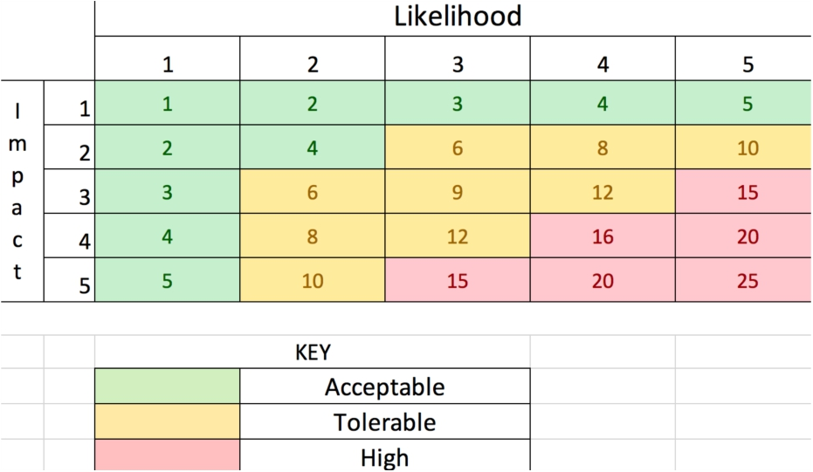
Risk Severity Matrix Example
17

Slide 9
Risk Table Example
This example is on Moodle
1. Sheet 1 (CLASS) – Risk severity matrix (different
from previous slide).
2. Sheet 2 (RISK) – this table.
Potenti al Risk | Potential Causes | Severity | Likelihood | Risk | Mitigation
Missed deadline | Illness | 1 | 3 | 3 | Register exceptional circumstances if ill.
 | Cannot choose topic | 1 | 1 | 1 | Conduct research early and meet supervisor
 | Poor time management | 4 | 3 | 12 | Make a Gantt plan early
Feature creep | Over-ambitious project spec. | 3 | 2 | 6 | Discuss plan with supervisor early. Create basic (must-have) goals and enhancements (nice-to- h
Software bugs | Non-modular design | 1 | 3 | 3 | Create highly modular desigh before implementation
 | Poor test plan | 4 | 3 | 12 | Create test plan at start
Loss of data | Poor version control | 4 | 4 | 16 | Implement version control strategy at start.

Slide 10
Professional Issues
Golden rule: treat others as you would like to be treated
● Legal: IPR, H&S, data protection, GDPR
● Professional codes of practice: next slide
● Personal: Personal values and standards
● Professional competence and integrity
● Social & Ethical: Moral issues and social responsibility
● Environmental

Slide 11
Professional Bodies
United Kingdom
– BCS - The Chartered Institute for IT (formerly British
Computer Society)
– Accredits your OBU degree
– Award prizes for OBU projects
– IET - Institution of Engineering & Technology
●
USA/Worldwide
– ACM -Association for Computing Machinery
– IEEE - Institute of Electrical and Electronics Engineers
●
All publish codes of practice / ethics: you can find these
online, use them! Cite them in your reports.
●

Slide 12
LEGAL Issues: Relevant Legislation
● Copyright, Designs and Patents Act, 1988
● Data Protection Act 2018 (includes GDPR)
● Privacy and Electronic Communications (EC) 2003
● Data Retention Regulations 2007
● Fraud Act 2006
● Computer Misuse Act 1990
● Communications Act 2003
● Regulation of Investigatory Powers Act 2000
● Electronic Commerce (EC Directive) Regulations 2002
● Disability Discrimination Act 1995

Slide 13
Computer Misuse Act 1990
For details, see: https://www.legislation.gov.uk/
Computer misuse offences
1. Unauthorised access to computer material.
2. Unauthorised access with intent to commit or facilitate
commission of further offences.
3. Unauthorised acts with intent to impair, or with
recklessness as to impairing, operation of computer, etc.
3ZA.Unauthorised acts causing, or creating risk of, serious
damage
3A.Making, supplying or obtaining articles for use in offence
under section 1, 3 or 3ZA
Example: Climategate

Slide 14
Data Protection Act
Overview
To balance the right to privacy of the individual versus the ability of organisations to use the data for the purpose of their business
History
Data Protection Act 1984: No right to privacy, Did not include paper
records
Data Protection Act 1998: Reflects the requirements of EU Privacy
Directive
Data Protection Act 2018: The UK's third generation of this law aims to modernise data protection laws so that they remain effective in the years to come. Applies GDPR.
Relevant European Union (EU) Directives Data Protection Directive
Privacy and Electronic Communications (PECR) Directive.
For details, see: https://www.legislation.gov.uk/

Slide 15
Intellectual Property Rights
Legal protection for ownership of ‘intangible assets’, e.g. music, literature, art etc.
§Copyright: I own and am credited for it, but you can copy, e.g. code,
images, content of your own paper
§Trademark: A sign, name, word, phrase, logo, symbol or design used to identify a product or service
§Patent: gives exclusive rights to the inventor
Oxford Brookes University: students working with companies
• OBU students are third parties legally and are therefore responsible for their own conduct and legal obligations. This means that if a student has access to Company Confidential Information then they may need to enter into an NDA with the company.
• OBU can provide a template https://www.brookes.ac.uk/research/policies-and-codes-of-practice/

Slide 16
ETHICS: in Research
Avoid:
Cheating – to get something by dishonesty or deception
Plagiarism – to steal the words of someone else and present
it as your own without crediting the source
Falsification of research data
Re-submitting previously submitted work without
acknowledgement
At Oxford Brookes
All research must go through a research ethics checklist –
this includes dissertations (forms E1 and E2)
If appropriate, the research must go through the School's
ethics officer and the University’s ethics panel

Slide 17
Ethics Template (Reminder)
If you are gathering requirements from human participants via, say, surveys, focus groups, or interviews then you need to obtain informed consent.
Information Sheet:
● An overview of what your project is about
Consent Form:
● Details such as data storage for GDPR
• University Ethics Forms and Templates
• University Guidelines for Informed Consent

Slide 18
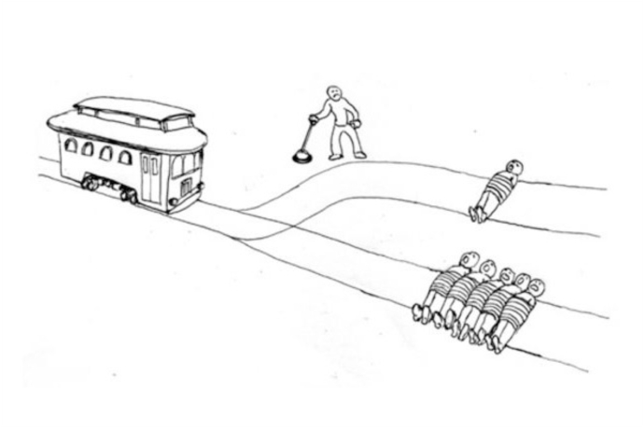
Infamous example of different ethical stances
Trolley dilemma: Autonomous Vehicles
● Which one will it be?
● Zoom poll

Slide 19
Infamous example of different ethical stances
Trolley dilemma: Autonomous Vehicles
Which one will it be?
– Consequentialism: less people should die (outcome)
– Deontology: active killing is bad (action)
●
● (People can not agree on ethical conduct)

Slide 20
Professional Bodies, e.g. IEEE Code of Ethics
1. to accept responsibility in making decisions consistent with the safety, health, and welfare of the public, and to disclose promptly factors that might endanger the public or the environment;
2. to avoid real or perceived conflicts of interest whenever possible, and to disclose
them to affected parties when they do exist;
3. to be honest and realistic in stating claims or estimates based on available data;
4. to reject bribery in all its forms;
5. to improve the understanding of technology; its appropriate application, and
potential consequences;
6. to maintain and improve our technical competence and to undertake technological tasks for others only if qualified by training or experience, or after full disclosure of pertinent limitations;
7. to seek, accept, and offer honest criticism of technical work, to acknowledge and
correct errors, and to credit properly the contributions of others;
8. to treat fairly all persons regardless of such factors as race, religion, gender,
disability, age, or national origin;
9. to avoid injuring others, their property, reputation, or employment by false or
malicious action;
10. to assist colleagues and co-workers in their professional development and to
support them in following this code of ethics.

Slide 21
ENVIRONMENTAL
Considerations with Computing
Some Advantages
• Less printing
• Working from home and virtual meetings mean less travel
•
Virtualisation: several computers on one machine saves resources
Some Disadvantages
• Energy consumption, including charging devices
•
Technological waster (e-waste) can contain environmental hazards
Professional Responsibility
•
Public interest: “You shall have due regard for public health, privacy, security and wellbeing of others and the environment.” BCS Code of Conduct

Slide 22
Example: Data Centres
Examples
• Microsoft, Amazon, Google, IBM, HP
•
Large facilities to house computer systems, which use vast amounts of energy.
•
Companies are bound by laws around environmental responsibility
Google 2019 Environmental Report: “In 2018, we achieved twelve consecutive years of carbon neutrality and, for the second year in a row, matched 100% of the electricity consumption of our global operations with renewable energy.”
•
Further Reading
● CACM Letter: some useful references.
● IEEE Draft Standard: check access via library
● Apple Environmental Responsibility Report 2018

